Slide 1
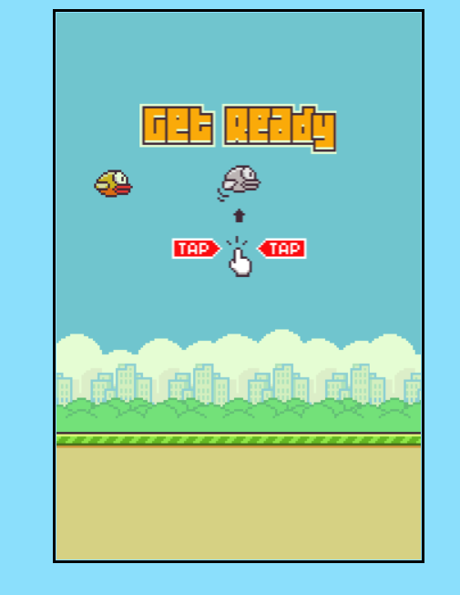
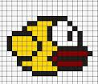
Flappy Bird Game With Pure JavaScript
* Presented by:
Abdelrahman Mohamed Ehab Mohamed
* Presented To:
Eng./ Marihan

Slide 2
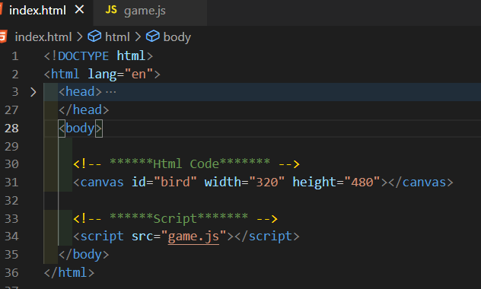
HTML Code

Slide 3
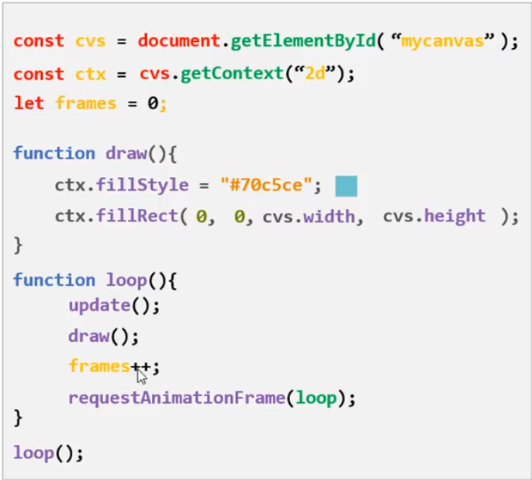
Java Script Code
Draw to The Canvas :

Slide 4

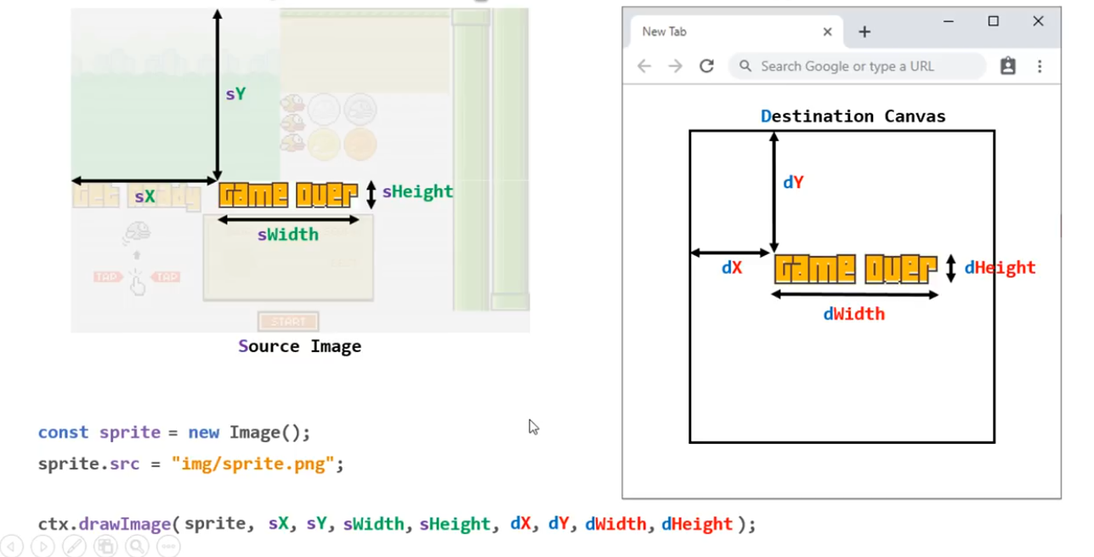
Java Script Code
Draw image to The Canvas :

Slide 5
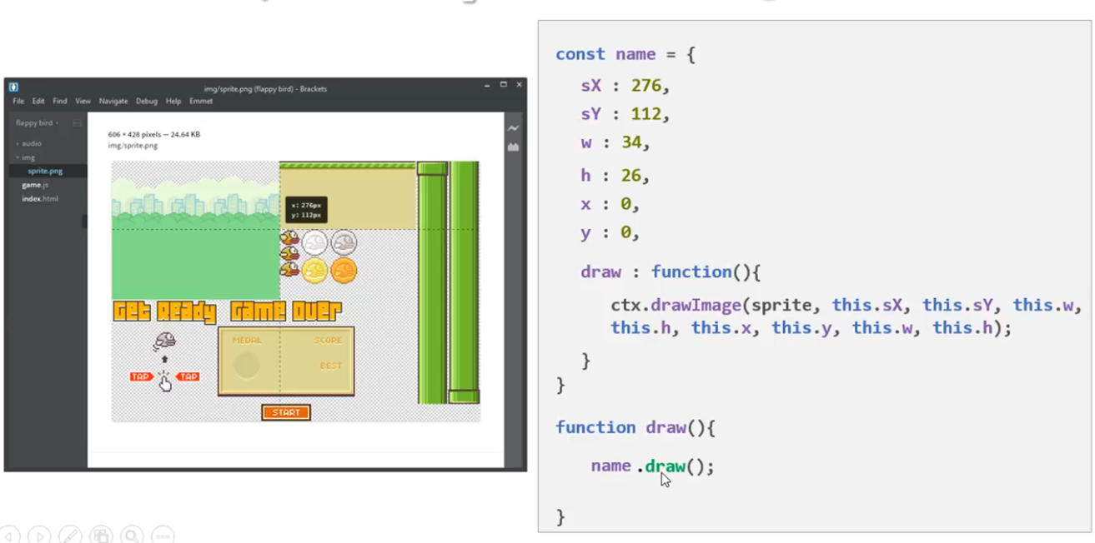
Java Script Code
Draw image to The Canvas :

Slide 6
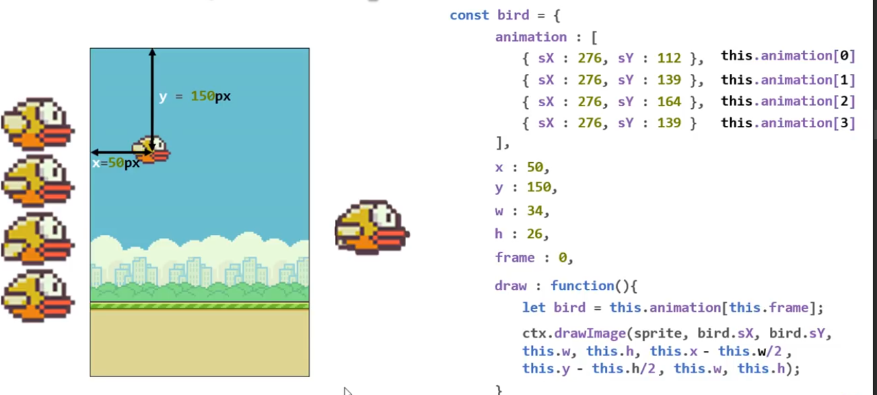
Java Script Code
Draw The Bird:

Slide 7
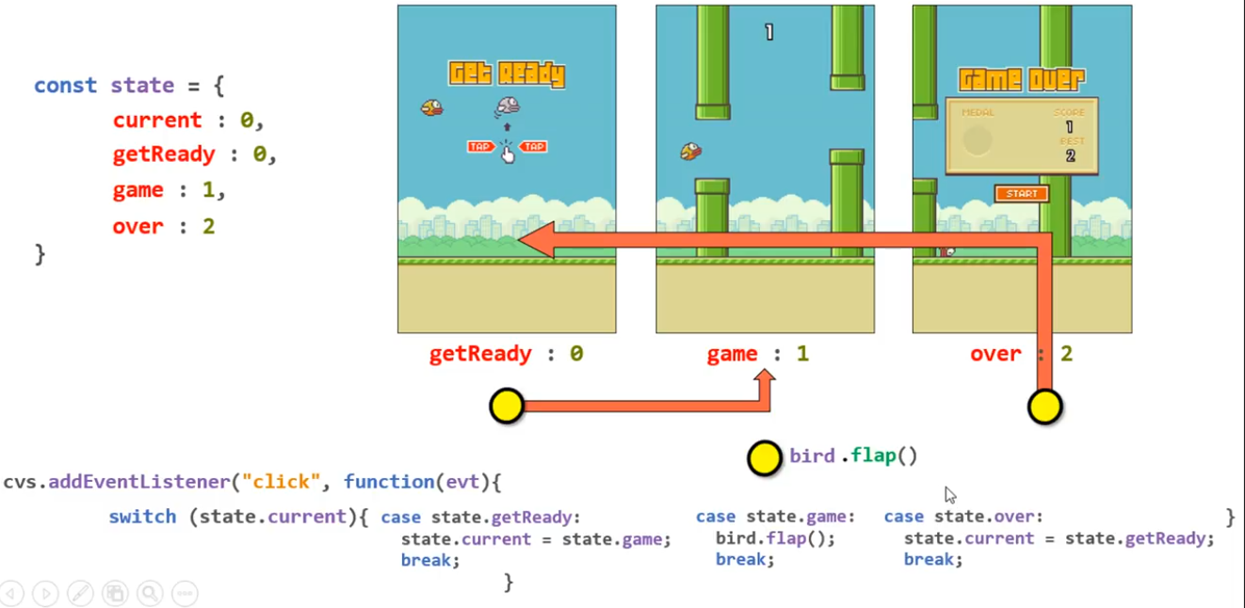
Game State:
Java Script Code

Slide 8
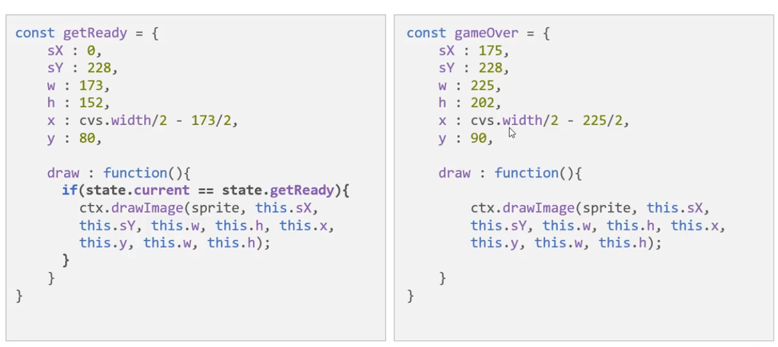
Java Script Code
Handle The States:

Slide 9
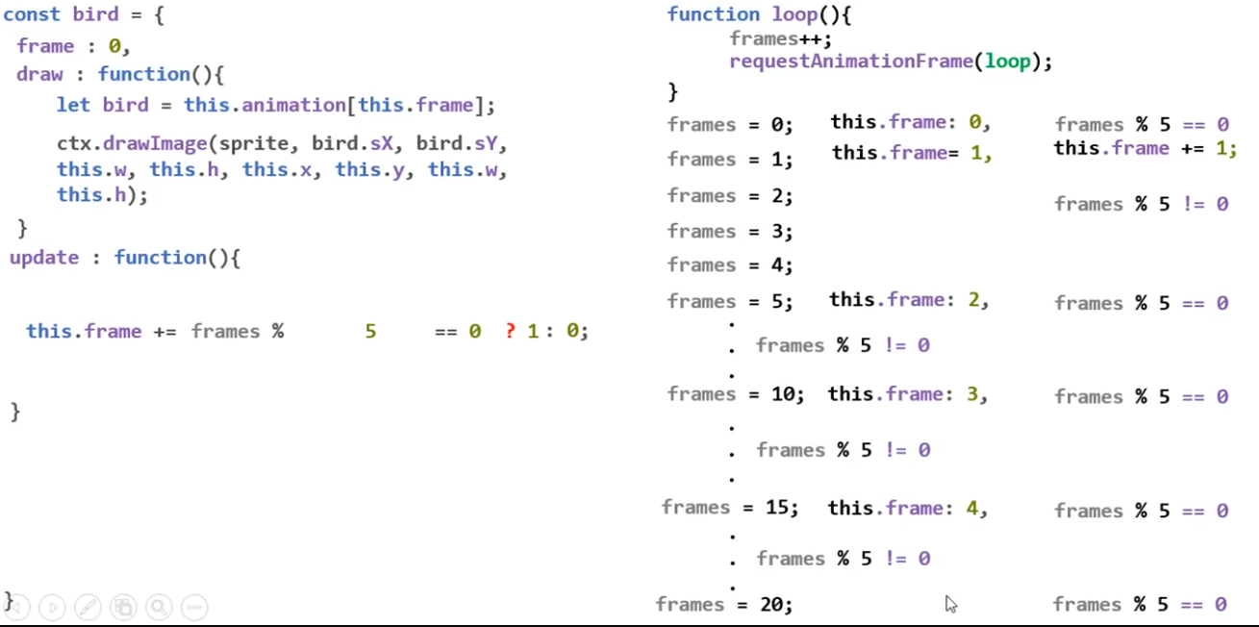
Animation of the bird:
Java Script Code

Slide 10
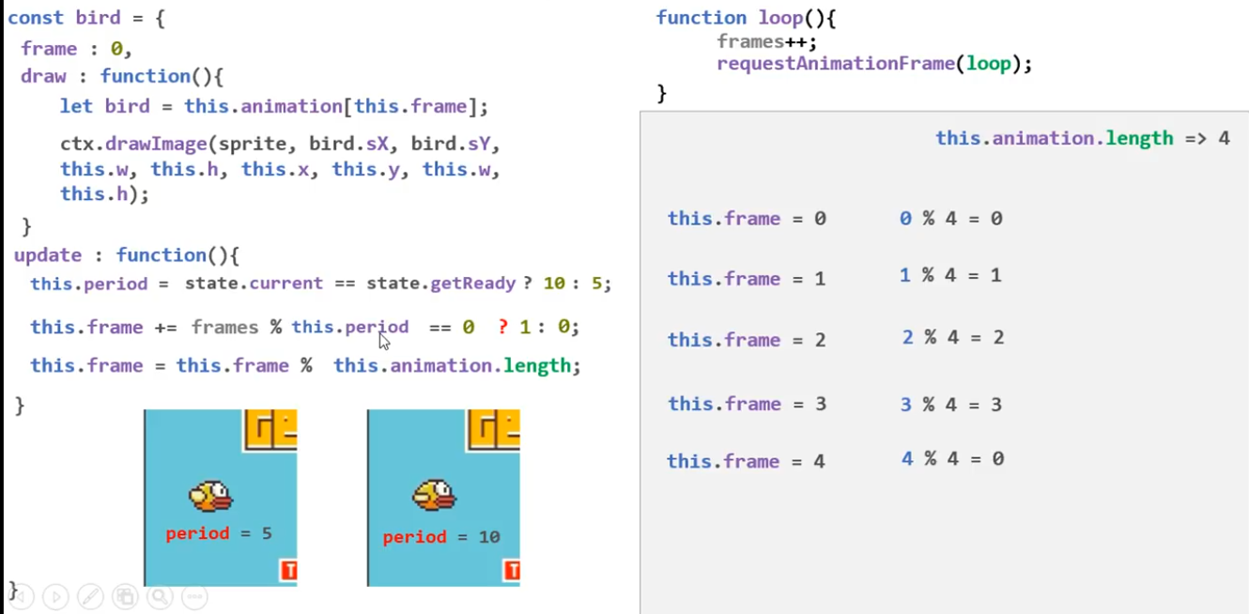
Java Script Code
Animation of the bird:

Slide 11
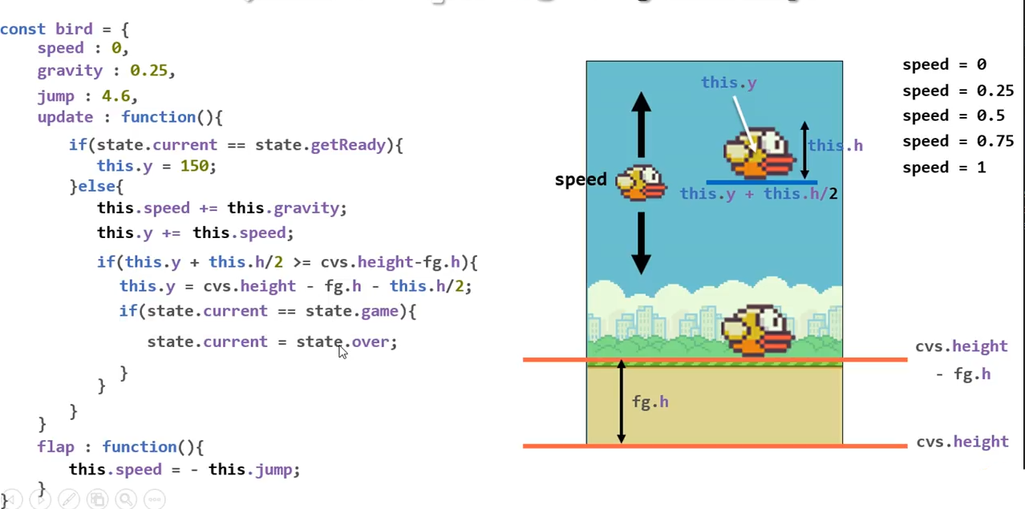
Java Script Code
Control the gravity and flap:

Slide 12
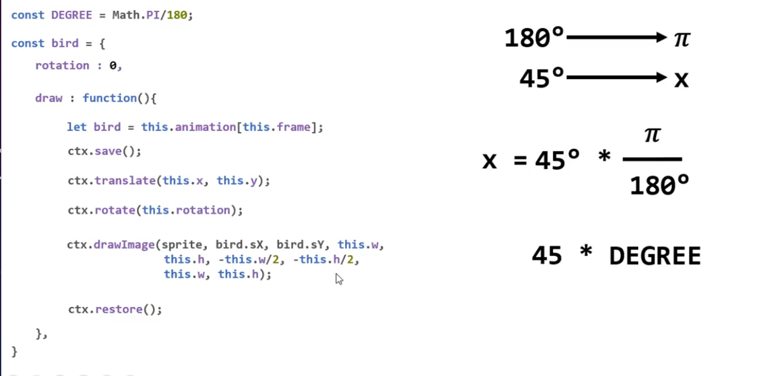
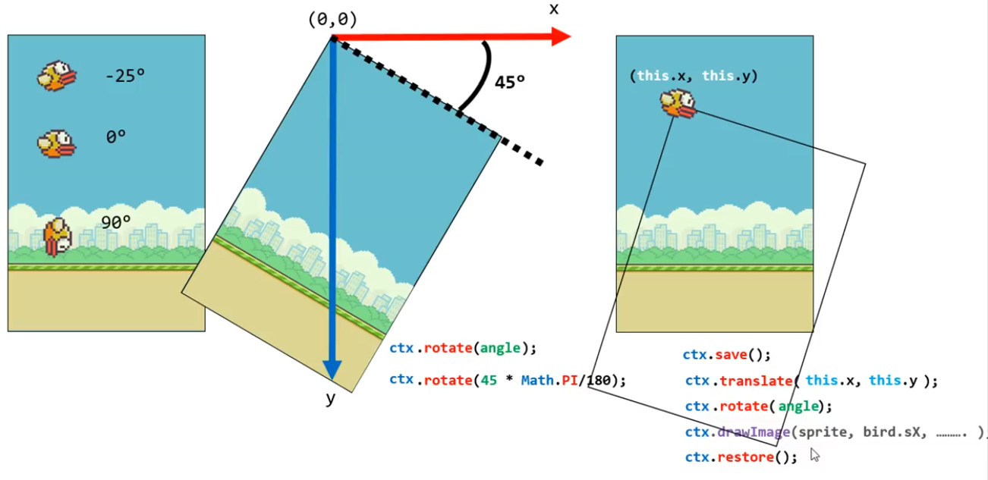
Java Script Code
Bird Rotation:

Slide 13
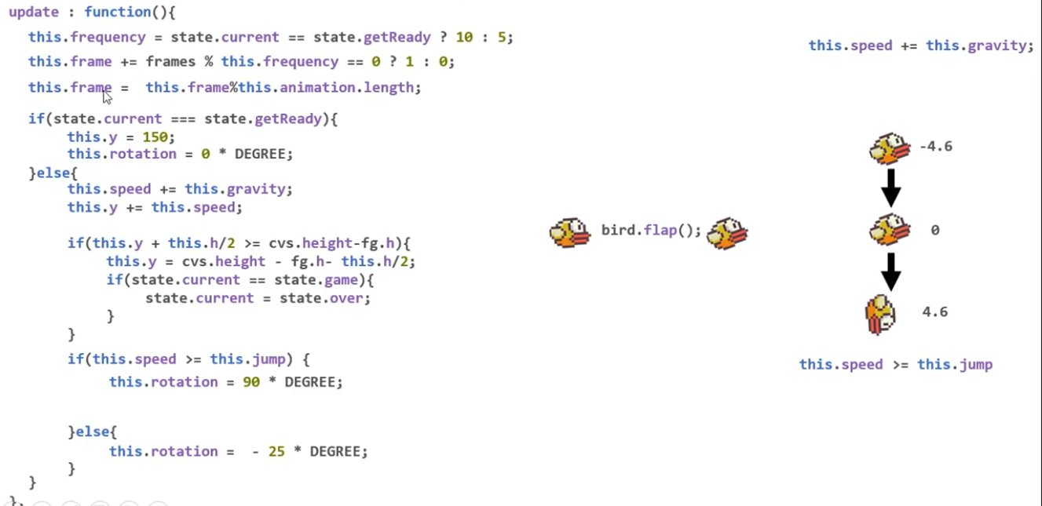
Bird Update:
Java Script Code

Slide 14
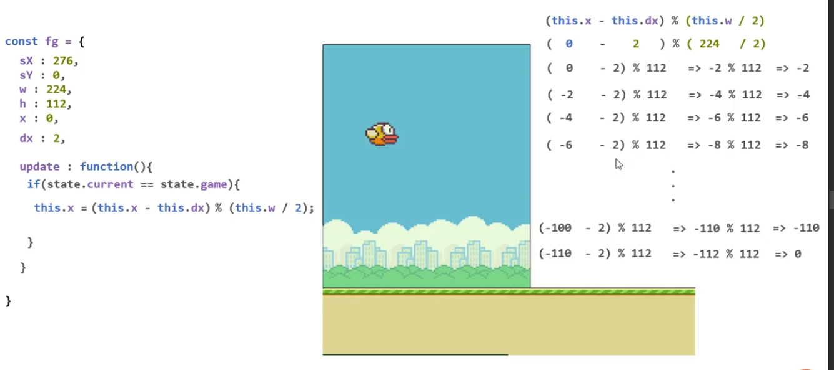
Move ForGround:
Java Script Code

Slide 15
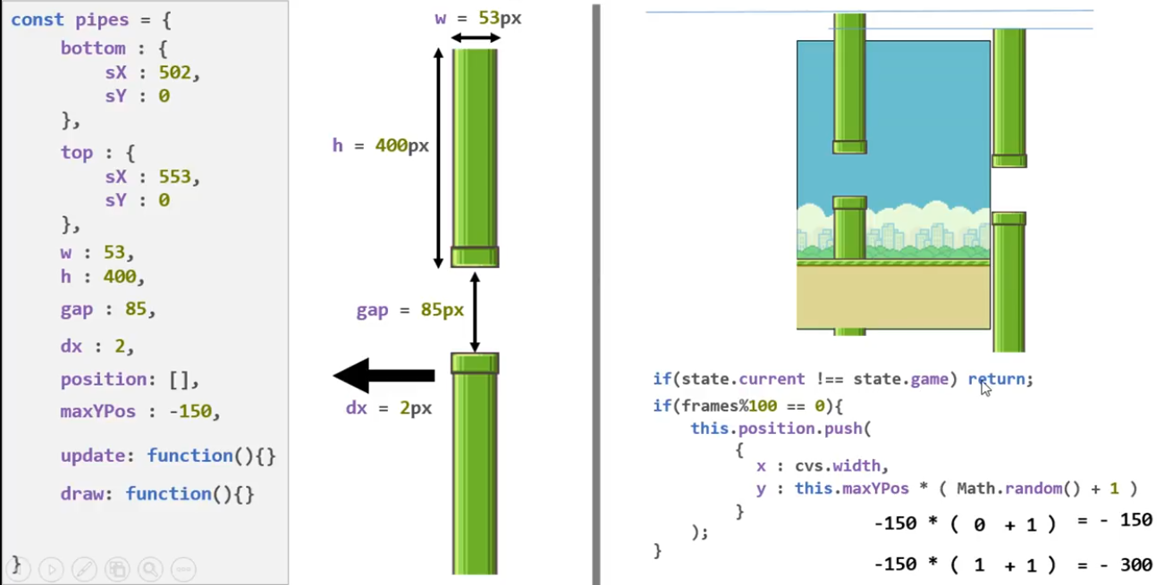
Create The Pipe:
Java Script Code

Slide 16
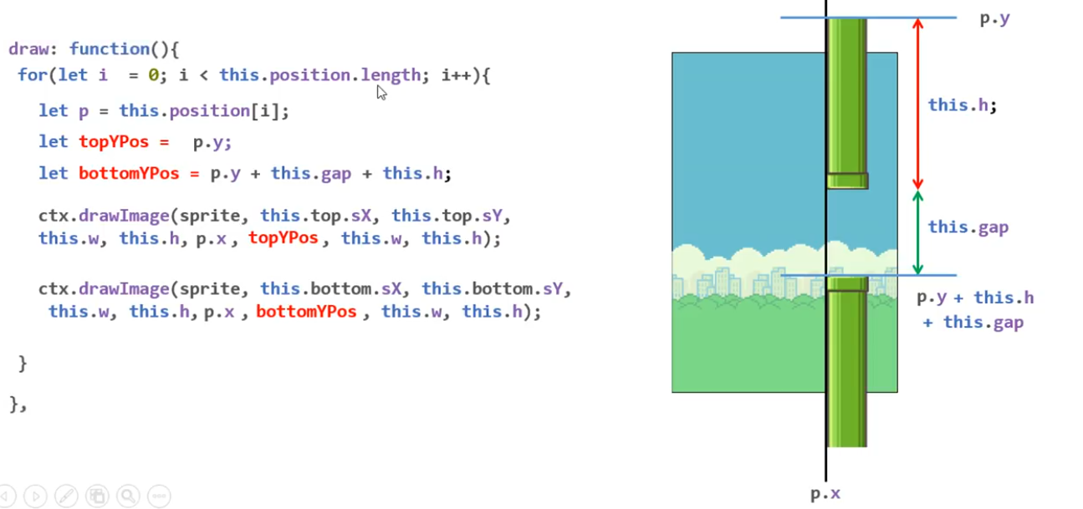
Draw The pipes :
Java Script Code

Slide 17
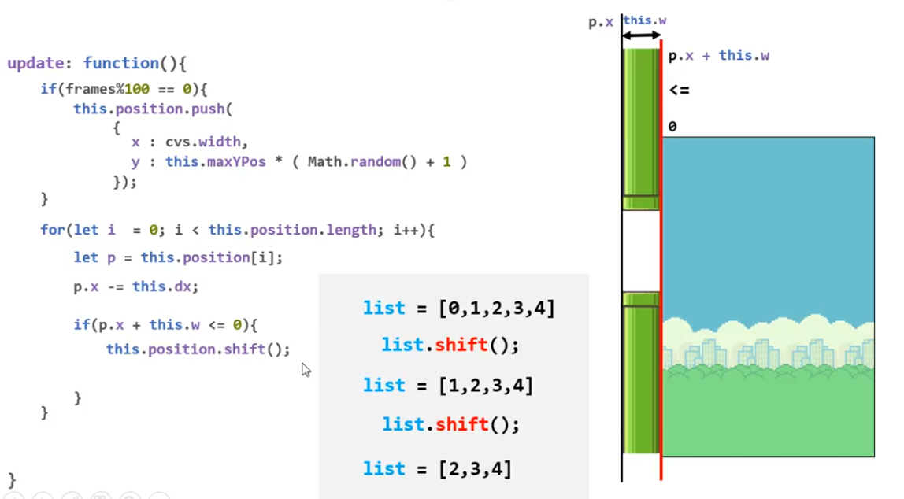
move the pipes :
Java Script Code

Slide 18
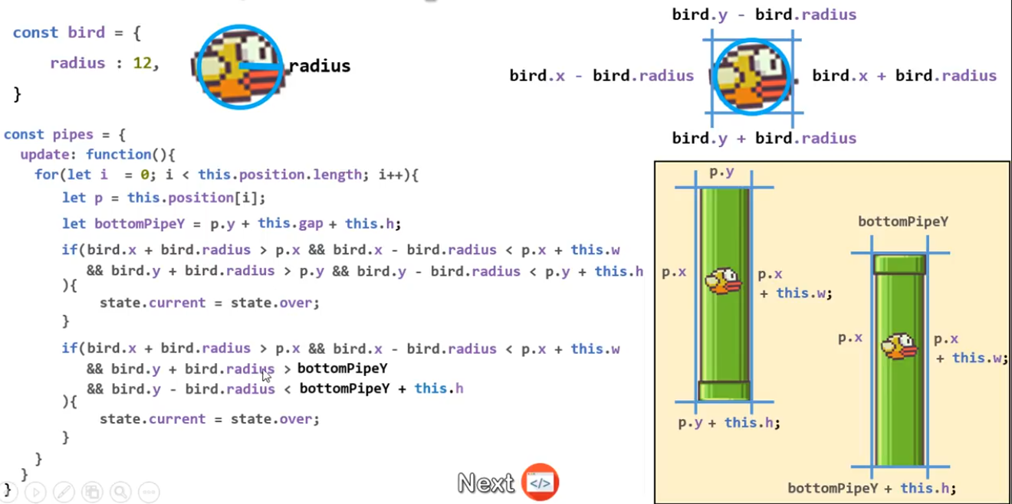
Collision detection:
Java Script Code

Slide 19
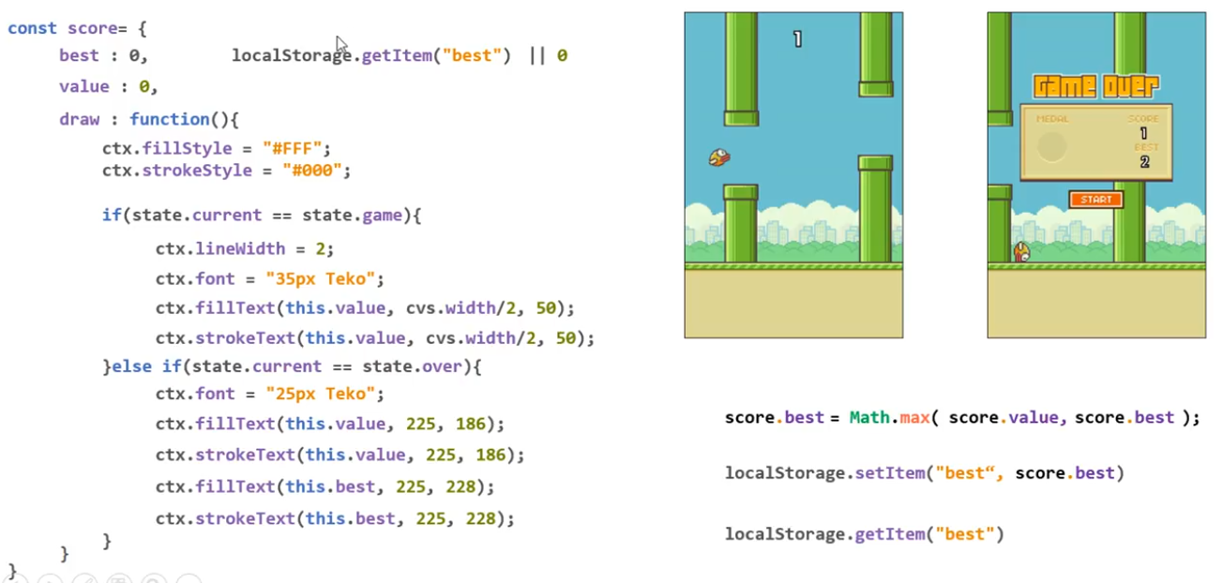
Java Script Code
SCORE:

Slide 20
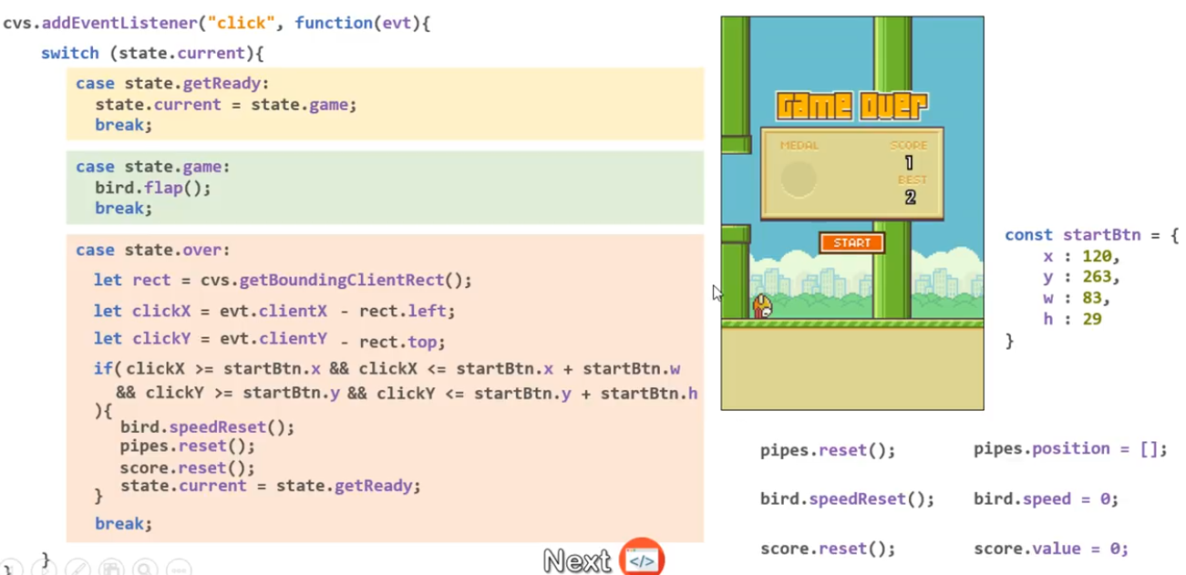
Java Script Code
Handle Click Event:

